Slide 1


Capstone Project 2
Bike Sharing Demand Prediction
(Supervised Machine Learning Regression)
Presented By:
TEAM- Insider
Chetan Prakash
Pallavi Wagh
Kaushik Dey
Hrushikesh Dharamthok
Prabhat Rajput

Slide 2
Why rental bike needed and why Analyse it?
Seoul city locals can rent bicycles for a charge and for a set period of time. However, the demand for motorbikes varies according to various variables, and they cannot keep up. Our approach aims to estimate demand for rented bikes at any given time, considering all factors that will assist in regulating the flow of motorbikes. Rental bikes are already available in numerous urban locations to increase transit convenience. It is critical that the rental bikes are accessible and available to the general public at the proper time since this eliminates waiting. Maintaining a consistent supply of rental bikes for the city eventually emerges as a major issue. The ability to estimate the number of bikes needed each hour is essential. We are going to explore the machine learning algorithms which function effectively with the data and the factors that have a significant impact on the demand for rented bikes.

Slide 3
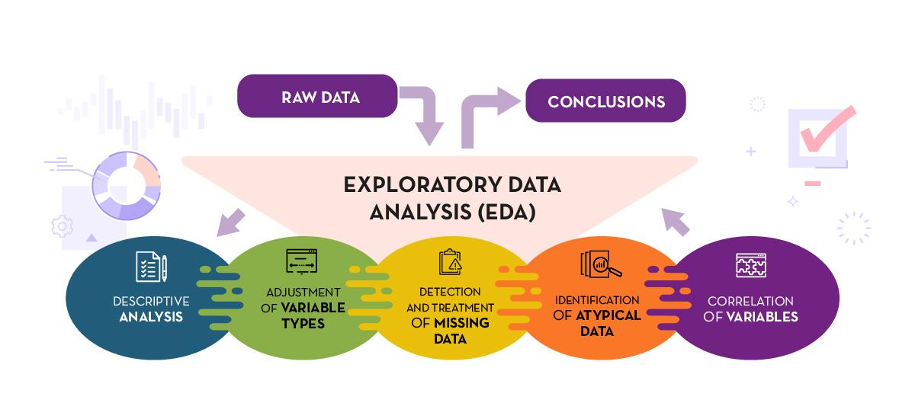

What is Exploratory Data Analysis (EDA) and Machine Learning (ML)?

Slide 4
Data Collection and Understanding on Seoul Bike Dataset :-
The data-set contains the following columns:
Date : Year-Month-Day.
Rented Bike Count : Count of bikes rented at each hour (Target Variable i.e Y variable).
Hour : Hour of the Day.
Temperature : Temperature in Celsius (°C).
Humidity : Humidity in Percentage (%).
Wind Speed : m/s.
Visibility : m.
Dew Point Temperature : Celsius (°C).
Solar Radiation : MJ/m2.
Rainfall : mm
Snowfall : Cm
Seasons : Winter, Spring, Summer, Autumn.
Holiday : Holiday/No holiday
Functioning Day : NoFunc(Non Functional Hours), Fun(Functional Hours).

Slide 5
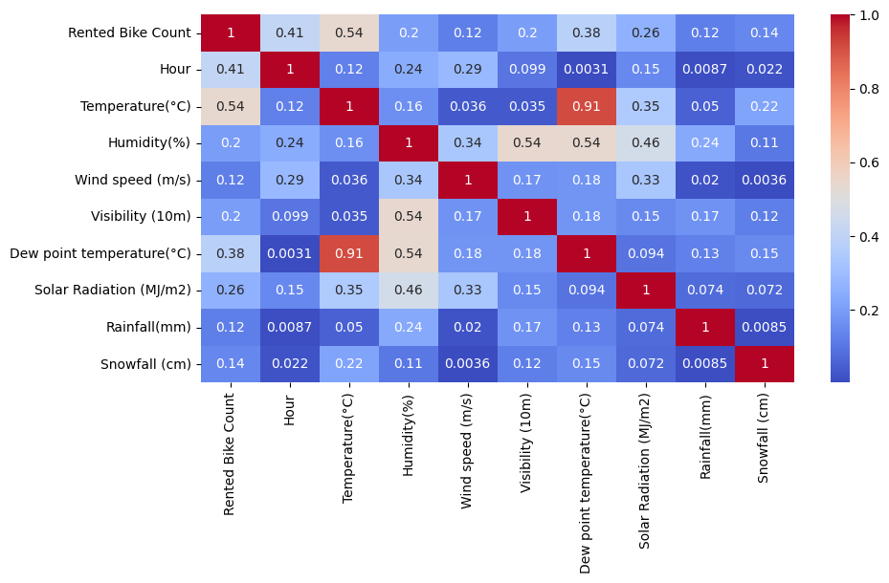
Finding the Insights :-
So we can see that there are collinearity present in between Dew Point temperature and Temperature(value=0.91), so we have to remove it because it affect the accuracy of the model.

Slide 6
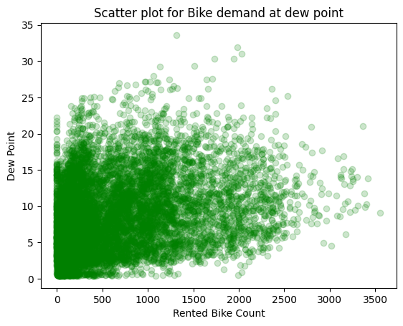
Feature Engineering:
Feature Creation: To remove multicollinearity create a new feature named as Dew Point. Dew point is basically made from two features i.e. Temperature and Dew Point Temperature.
Feature Drop: After creation of a new feature drop the original features i.e. Temperature and Dew Point Temperature. But it again shows multicollinearity between Dew Point and Humidity(%) so drop Humidity as well. And also Date feature is drop due to splitting.
Feature Split: To deal with Date feature split it into three new features i.e. Day, Month, Year.
Dummification: All the object features need to be dummyfy because of model fitting.

Slide 7
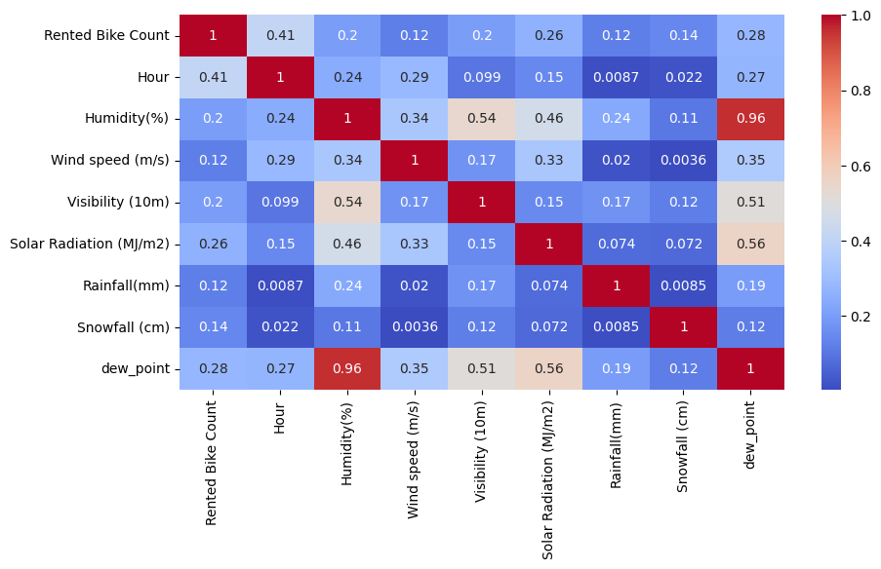
Again checking the correlation:
There is high multicollinearity generate between dewpoint and Humidity. So we drop it for the better model accuracy with the help of feature engineering. Threshold value for multicollinearity is considered from 0.6 onwards.

Slide 8
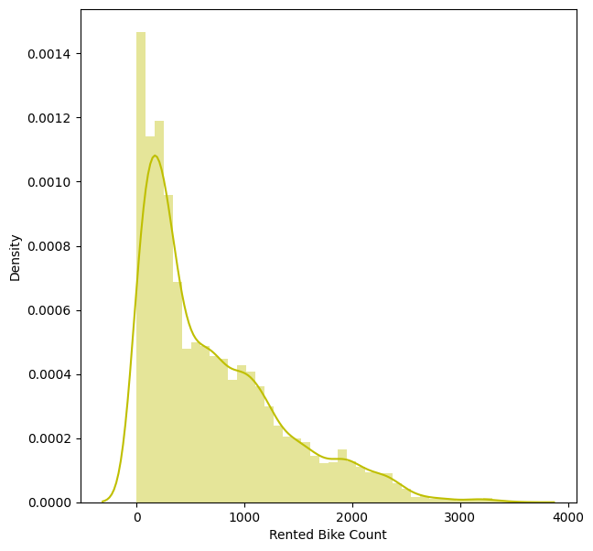
Density chart to check distribution of the Data:
Very high positive skewness present in the data. This type of distribution of data lead to lack of accuracy in the model.

Slide 9
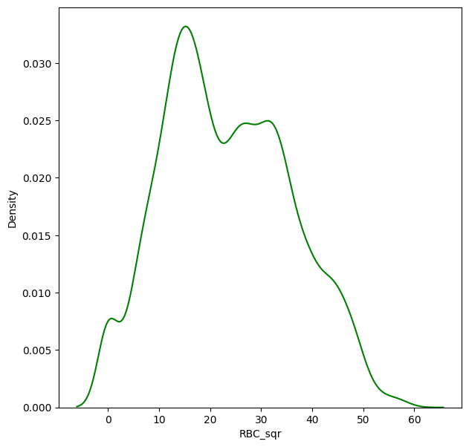
Normal distribution of the data with the square root method:
We use square root method because when we try with log10 it create error (data tends to infinity) because data have some negative or 0 value present in it.

Slide 10
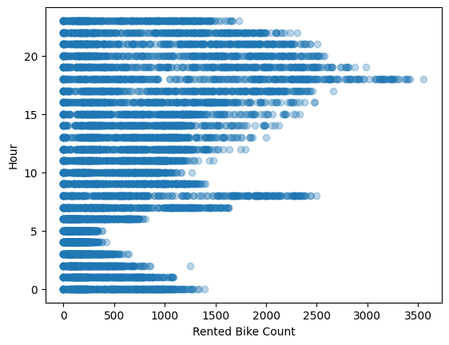
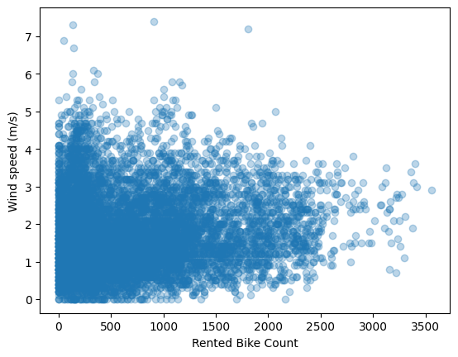
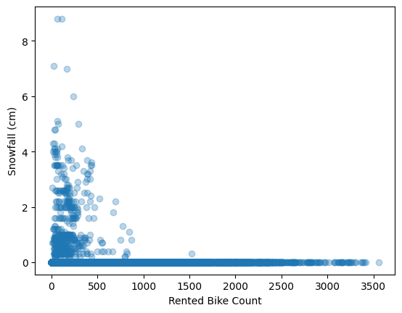
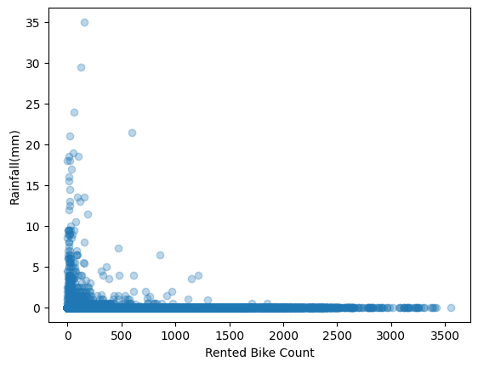
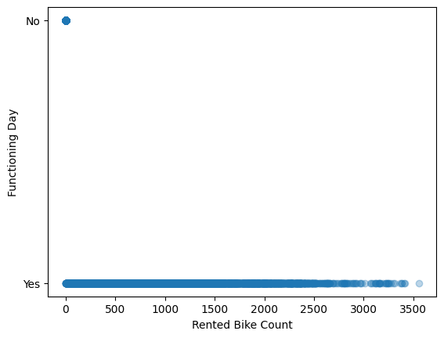
Function to show the relation between all the independent variable to dependent variable:
By these charts, we can take an idea about the demand for bikes at a particular instant like here we have Function Day which shows that we have negligible demands during No functioning day.

Slide 11
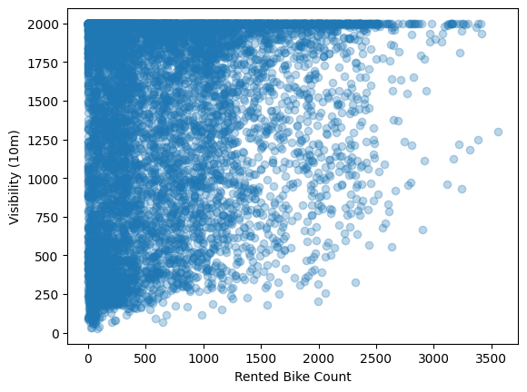
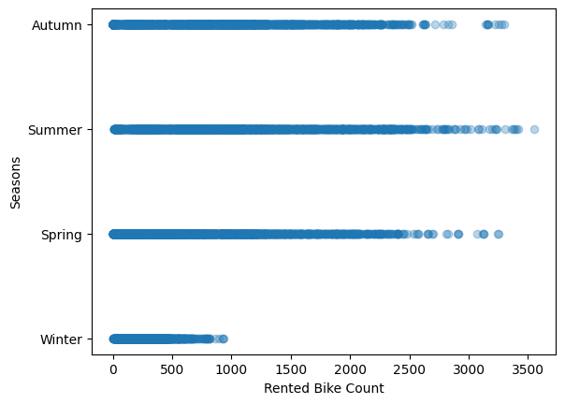
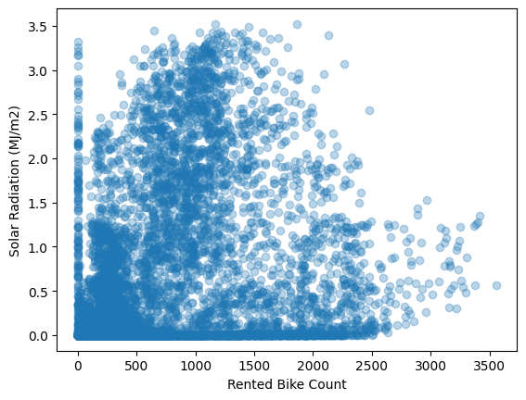
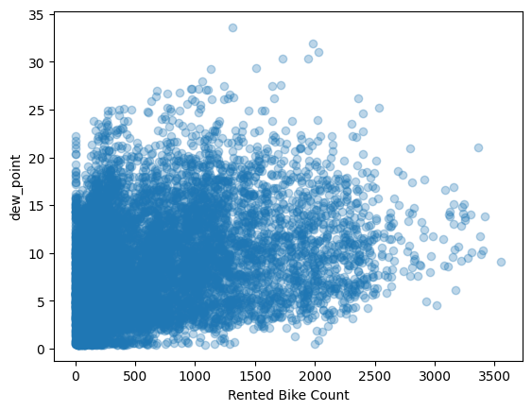
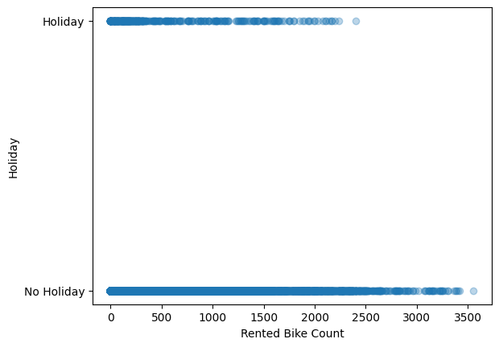
Some more charts show relations:
Some more charts show the relation.

Slide 12
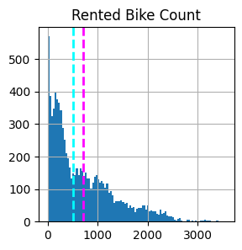
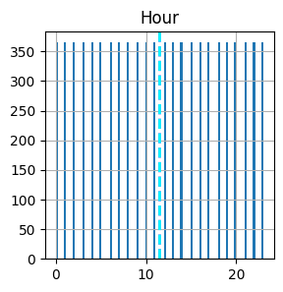
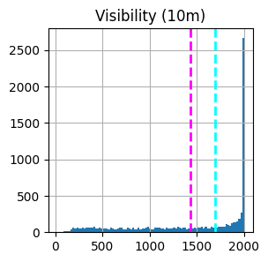
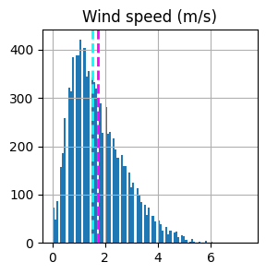
Chart shows the mean and median of each numeric values:
The mean value is the average value of a particular category and the median value is the half quartile or middle value by which half values are up and half values are down here mean is represented by magenta color and the median by cyan color like Rented Bike Count generally bikes are rented between 0 to 1000.

Slide 13
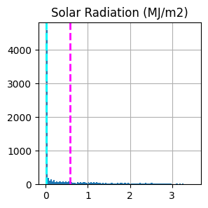
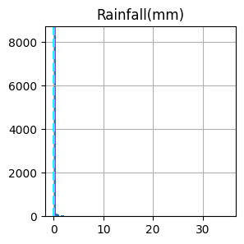
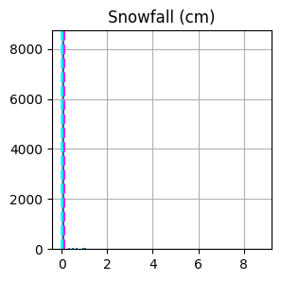
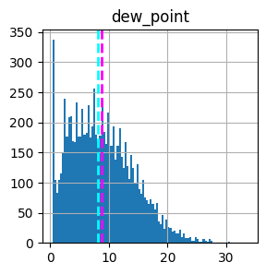
Some more charts show the mean and median values:
Some more charts show the mean and median value.

Slide 14
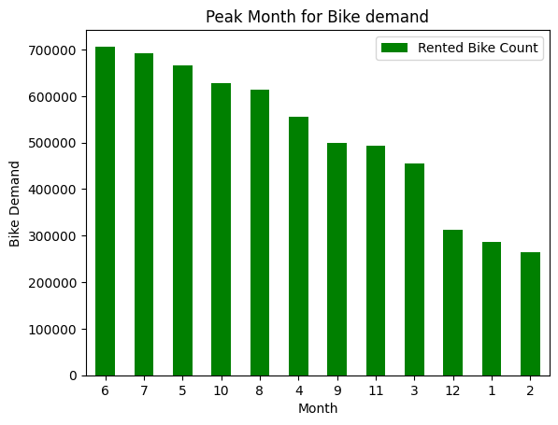
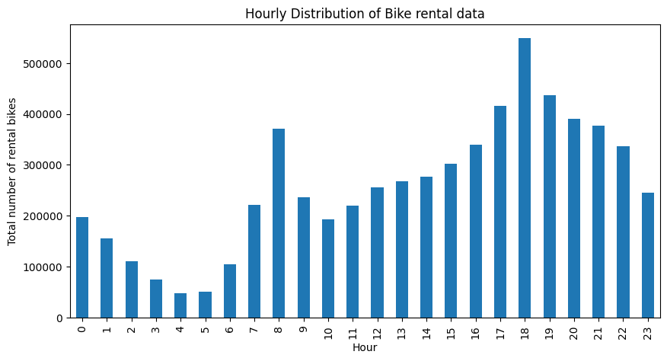
Peak Month and Hour:-
These charts showing the month which have highest demand and hour that at which hour the bike demand is maximum.

Slide 15
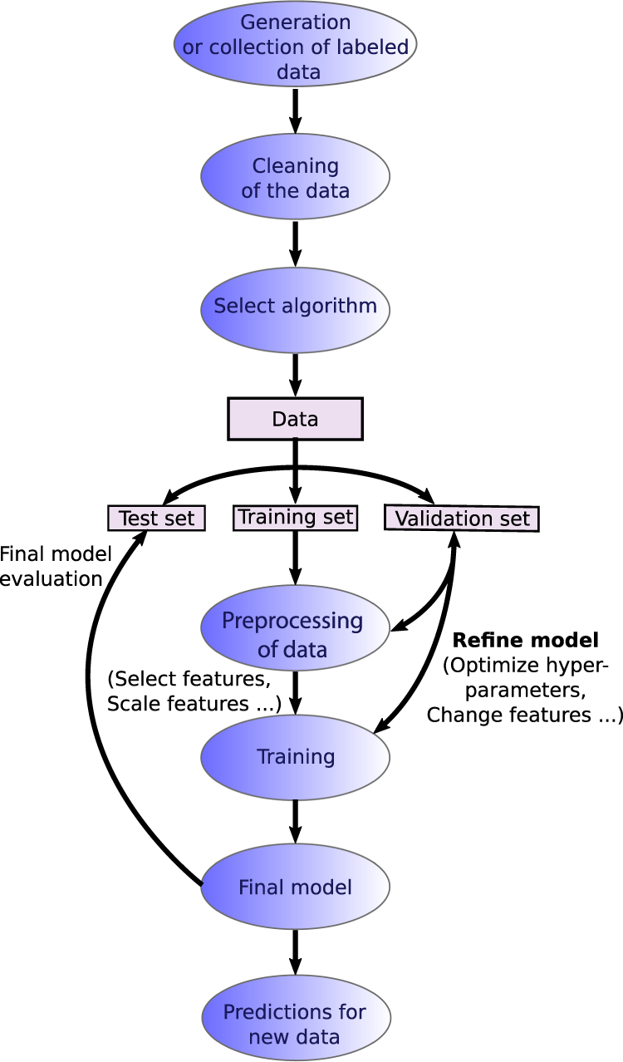
Model Fitting :-
Model fitting is basically the implementation of testing and training data into different-different algorithms.
Here we use 6 algorithms for finding the accuracy of the result.
Linear Regression Algorithm
Lasso Regression Algorithm
Ridge Regression Algorithm
Elastic Net Regression Algorithm
Decision Tree Regression Algorithm
Random Forest Regression Algorithm

Slide 16
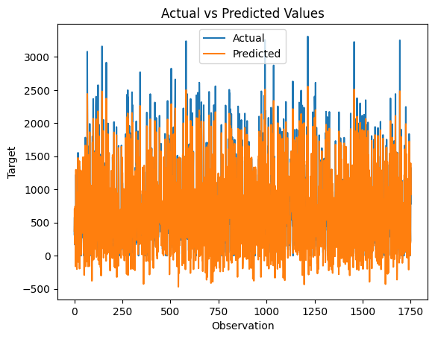
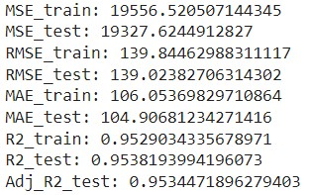
Linear Regressor :-
MSE=Mean Squared Error
RMSE= Root Mean Squared Error
MAE= Mean Absolute Error
R2 Score= Variance Proportion
R2 Adjusted=Modified version of R2
Train means training data.
Test means testing data.
We take 70:30 ratio for splitting purpose.

Slide 17
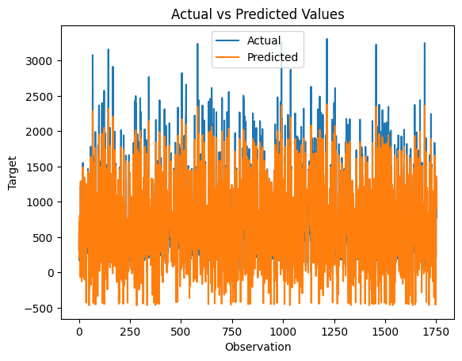
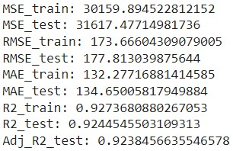
Lasso Regressor with Cross Validation :-
MSE: The Mean Squared Error measures how close a regression line is to a set of data points.
RMSE: It measures the average difference between values predicted by a model and the actual values.
MAE: The absolute error is the absolute value of the difference between the forecasted value and the actual value.

Slide 18

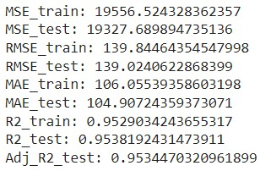
Ridge Regressor with Cross Validation :-
R2: R2 is coefficient of determination is a statistical measure of how well the regression predictions approximate the real data points
R2 Adjusted: A modified version of R-squared that has been adjusted for the number of predictors in the model.

Slide 19
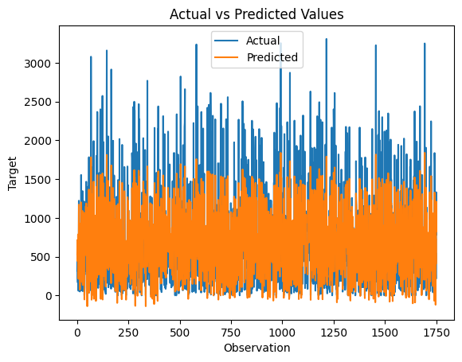
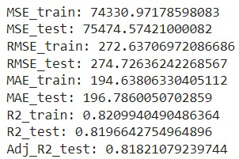
Elastic-Net Regressor with Cross Validation :-

Slide 20
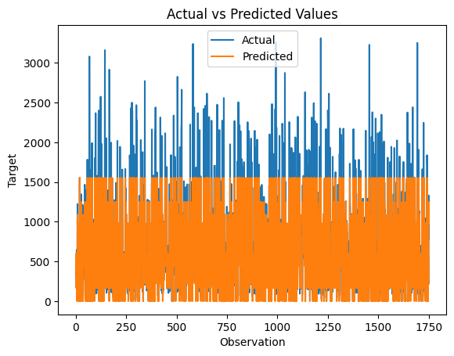
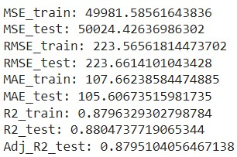
Decision Tree Regressor :-

Slide 21
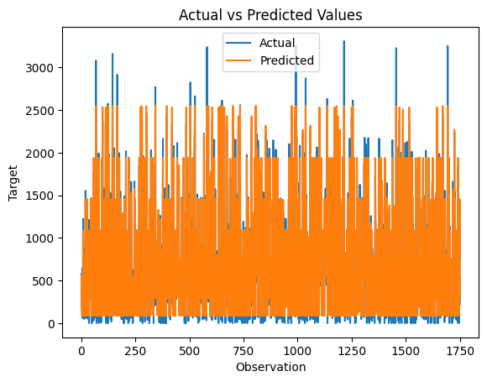
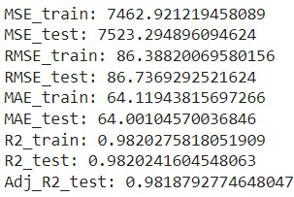
Random Forest Regressor with Grid Search Cross-Validation :-

Slide 22
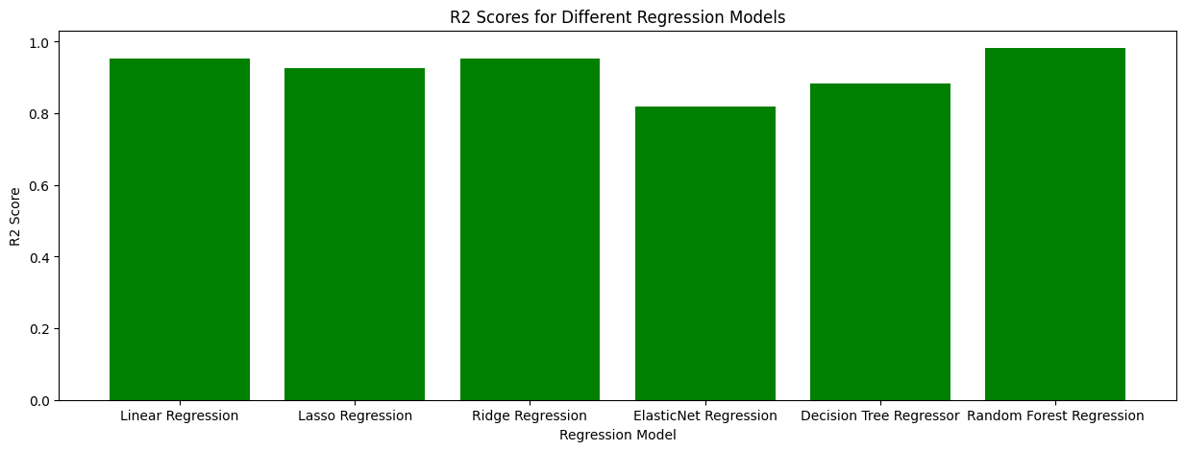
Visualize all the Regression R2 values :-
Random Forest Regression has the highest accuracy.

Slide 23
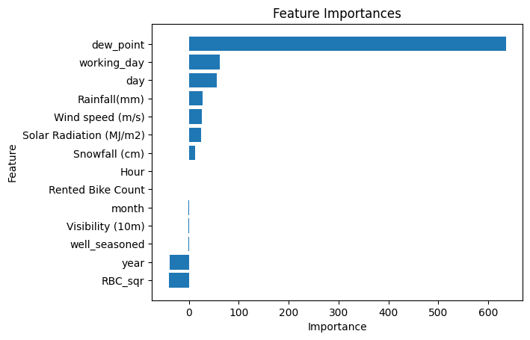
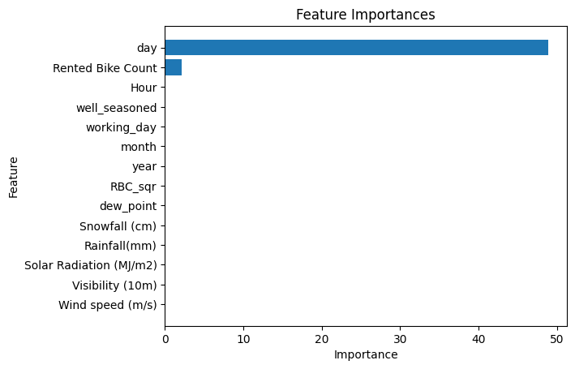

Feature Importance:
These charts show the most important feature find during model fitting in Linear Regression, Lasso Regression, and Ridge Regression.

Slide 24
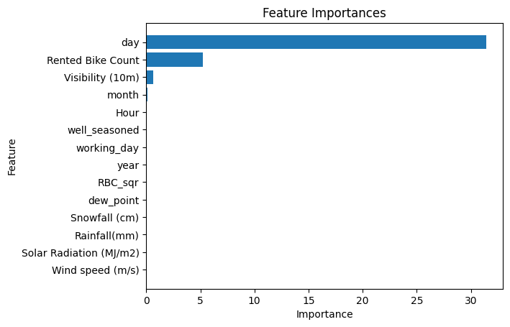
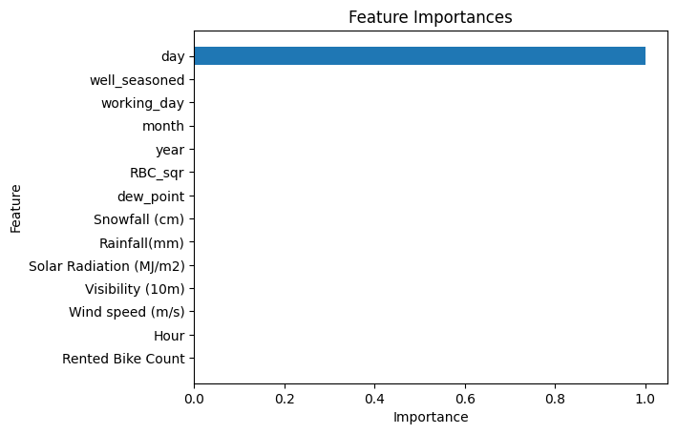
Feature Importance:
These charts show the most important feature find during model fitting in Elastic Net Regression, Decision Tree Regression, and Random Forest Regression.
From these charts Day is the most important feature.

Slide 25
Steps Need to Consider for Business Context:-
To achieve the business objective, I would suggest the following steps for the client:
Data Collection and Cleaning: The initial stage involves collecting data from a variety of sources, including bike rental providers, weather reports, local events, etc., and cleaning the data by eliminating any duplicates or discrepancies.
Choose Relevant factors: Once the data has been cleansed, it is critical to choose relevant factors that might influence demand for bike sharing, such as weather conditions, time of day, day of week, and so on.
Set up a Predictive Model: The customer may then use the appropriate data to create a predictive model that can precisely estimate the demand for bike sharing. For this, a variety of machine learning methods, including decision trees, and linear regression, can be utilized.
Test and improve the model: After creating the model, it is critical to test it on a subset of the data to confirm that it appropriately predicts bike-sharing demand. If the model is underperforming, the client should improve it by changing the features or using a new algorithm.
Launch and Monitor the Model: Once the model has shown to be effective, it may be used to produce real-time predictions. However, it is critical to track the model's performance over time to ensure that it continues to appropriately estimate bike-sharing demand. As new data becomes available, the model may need to be updated on a regular basis.
Take Action on Insights: Finally, the customer should take action on the model's outcomes. For example, if the model predicts that there will be a strong demand for bike sharing at specific times or in specific areas, the client may ensure that there will be enough bikes available in those areas to satisfy the demand

Slide 26
Some more point related to business context:
Geographical location: The demand for bike sharing can vary by geographical location. Certain areas or neighborhoods may have higher demand due to population density, proximity to popular tourist attractions, or the availability of bike lanes.
User behavior: Understanding user behavior and preferences can help to predict demand. For example, people may be more likely to use bike sharing for short trips or during rush hour.
Pricing and promotions: The price of bike sharing services and promotions or discounts can affect demand. For example, lower prices or promotions may lead to increased demand.
Bikes Maintenance: The availability of bikes and the frequency of bike maintenance can also impact demand. If there are not enough bikes available or if they are in poor condition, people may be less likely to use the service.
Competitor analysis: Analyzing the competition can help to identify opportunities for growth and areas where the business may be losing customers.
Marketing and outreach: Effective marketing and outreach can help to increase demand for bike sharing. Understanding the target audience and their preferences can help to develop effective marketing strategies.

Slide 27
Conclusion :-
The relationship between hour and bike count is random. Anytime is a good time to ride a bike.
Most frequently, 20 to 85% humidity is required for biking.
Mostly demand for bikes more when the wind speed is low.
Although we cannot identify a clear pattern in visibility, we can state that demand for bikes is often highest when visibility is best.
In areas with strong sun exposure, demand for bikes is often minimal.
When rainfall is unlikely to occur, people rent bikes.
Lack of demand for bikes during winter.
The demand for bikes is the same in the autumn, summer, and spring, but it is quite low in the winter.
Demand for bikes is highest on "no holiday" days and lowest on "holiday."
On a 'No function' day, we have very little demand.
Bicycle demand is typically between 0 and 20.
The sixth month has the biggest demand.
18th hour is the peak hour for bike demand

Slide 28
Some more points:
Day is the feature that has the most influence, while Dew Point comes in second for Linear and Ridge Regressor.
For Lasso, Elastic Net, Decision Tree, and Random Forest Regressor, the month is the most significant feature.
Visualization of Actual vs. Prediction is performed for all 6 models.
R2 Comparisons:
Linear Regression R2 : 0.9538193994196074
Lasso Regression R2 : 0.9244548788202334
Ridge Regression R2 : 0.9538192431473912
Elastic Net Regression R2 : 0.8196626252780658
Decision Tree Regressor R2 : 0.8804737719065344
Random Forest Regressor R2 : 0.981668168270039
Random Forest Regression is the best-performing model with an r2 score of 0.981668168270039.
ElasticNe Regression is the worst-performing model with an r2 score of 0.8196626252780658.

Slide 29


